Slide 1

PACCAR Testing Database

Slide 2
What we will be covering today
- How I decided what to make
- How I made it
- How it works
- Demonstration
- Test
- Challenges along the way
- What I learned
- Conclusions / Future Enhancements

Slide 3
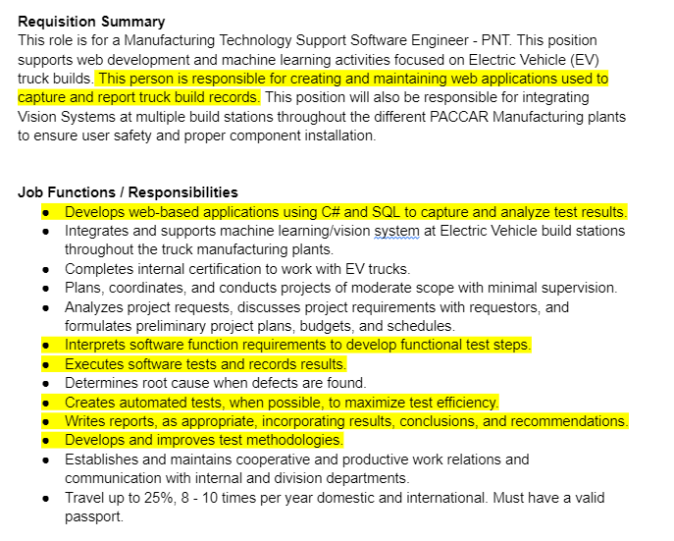
How I decided what to make
AKA Requirements Gathering
Web application used to capture and report truck record builds
Using C# and SQL to capture and analyze test results
Develop function requirements to develop functional test steps.
Execute software tests, record results.
Create automated tests to maximize efficiency.
Write report with results.
Develop tests.
Familiar with CSS and Javascript frameworks (Bootstrap, jQuery, etc.)

Slide 4
Program Requirements
The pieces I need to use
C# based web application
Database made in SQL
Incorporate Bootstrap, jQuery
Take user input for a test result
Store that result in a database
Allow for a graphical interpretation of that information
Test that the information being input is correct
Generate a report based on those tests

Slide 5
Execution
Step 1- Map out the functionality
Step 2- Create the database
Step 3- Create the basic MVC framework- Models, then controllers, then views.
Step 4- Recreate the database in my program
Step 5- Expand functionality- take user input
- Test that the user input is being input correctly (manually)
Step 7- Refine user input to improve the UX and reduce chance for error.
- Retest
Step 6- Expand functionality- Create a general graphing function.
- Test that the graphing function is displaying data correctly (manually)
Step 7- Filter graphing functions by Truck and by Test
Create the testing program and test set.
(How I made it)

Slide 6
Architecture
(How it works)
Model / View / Controller Architecture
Why?
Straightforward model with lots of documentation available.
Easily combines front and back end technologies.
Ease of modification.
Testability- Testing program was implemented within same solution.
Scalability- Models / Views can be reused

Slide 7
Technologies used
Framework- .Net 8.0
Database- Microsoft SQL Server Management Studio
Back End- C#
Front End- CSHTML / CSS
Dynamic dropdown menus- jQuery / Bootstrap
Graphing- Newtonsoft.Json, Chart.js, HTML5 Canvas
Testing- MSTEST
Version Control- GitHub

Slide 8
tESTING
(Making sure I didn’t screw this up)
Two
something that presented some technical issues, then show how you were able to overcome.
please prepare a 15 to 20 minute presentation that’s related to an engineering project you worked on that demonstrates your knowledge and abilities.

Slide 9
Functionality
So, what does it do?

Slide 10
Present Program

Slide 12
Potential Additions
More checks for valid user input
Machine learning to forecast scores based on past data
Automatic formatted report generation

